Slide 1


Social
Buzz

Slide 2


Today's agenda
Project recap
Problem
The Analytics team
Process
Insights
Summary

Slide 3

An audit of their big data practice.
Recommendations for a successful IPO.
An analysis of their content categories that highlights the top 5 categories with the largest aggregate popularity
Project Recap

Slide 4

Problem
Managing Explosive Growth.
Data Management and Analysis.
Preparing for an IPO.
Lack of Internal Expertise.

Slide 5



Andrew Fleming (Chief Technical Architect)
The Analytics team
Marcus Rompton (Senior Principle)
Sreedatta (Data Analyst)

Slide 6
Process
1
Problem Definition and Data Collection
2
Data Cleaning and Preparation
3
Exploratory Data Analysis (EDA)
4
Modeling and Analysis
5
Deliver Insights and Recommendations

Slide 7



Insights
Avg Score of Content Type are:
Top5 Categories are:
Top5 RectionTypes are:
Animals
science
healthy eating
technology
food
travel

Slide 8
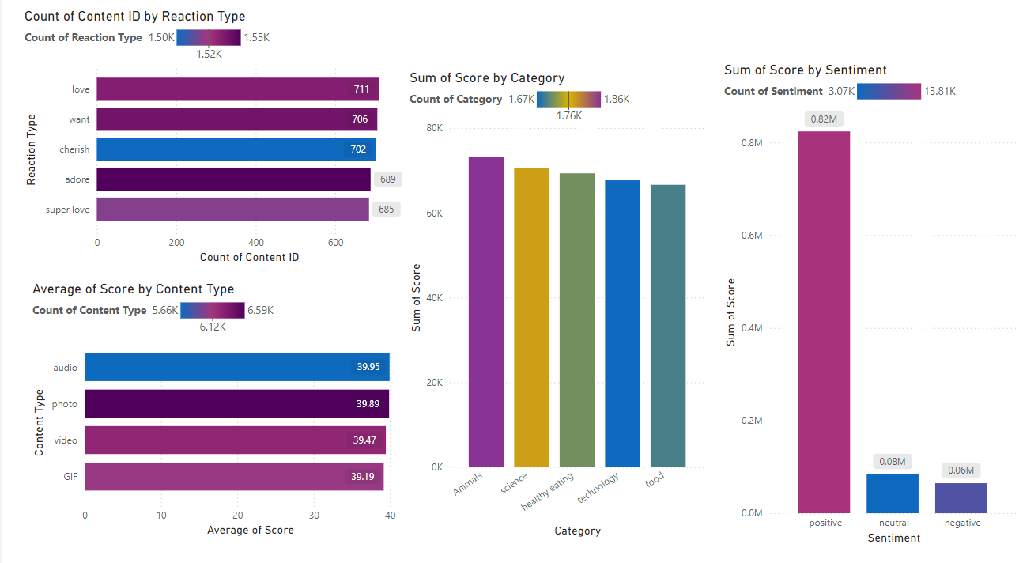

Slide 9

Content Performance:
Reaction Types: The "love" reaction is the most popular, followed by "want" and "cherish."
Content Types: Videos and photos are the most popular content types, followed by GIFs and audio.
Content Categories: "Animals" and "science" are the top-performing categories in terms of the sum of scores.
Summary

Slide 10
Thank you!
ANY QUESTIONS?

